Slide 1
Unit6: History of Life

Slide 2
What is life??
Energy
Inherent capacity of organisms
Utilization of
outside
materials
Growth
Reproduction

Slide 3
Answer??
How, Where & When life originated?
The way in which simple life forms gave rise to different kinds of organisms

Slide 4
BIG-BANG THEORY

Slide 5
Big-Bang Theory
Proposed by Abbe Lemaitre in 1931.
About 20 billion years.
Scientists estimated approx. 100000 million galaxies in the universe.
Our Solar System # The Milkyway or Akash Ganga

Slide 6
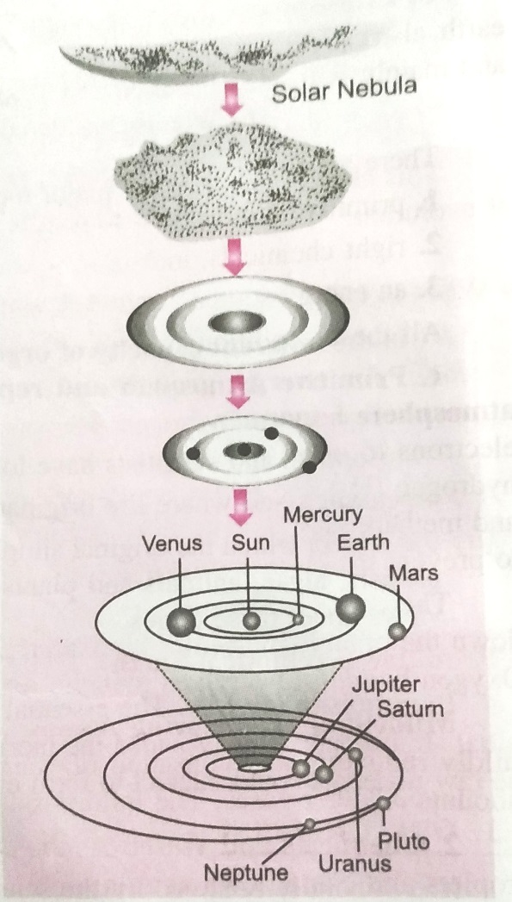
Formation of our solar system:
Eddies

Slide 7
Conditions for the Origin of Life:
Primitive atmosphere with little or no oxygen.
Chemicals and Water
Energy sorces

Slide 8
Theories:
Theory of Special Creation
Theory of Spontaneous Generation
Modern Theory

Slide 9
Theory of Special Creation:
Acc to Christian belief- God created the universe in 6 natural days. Adam and Eve were the man and woman created by the God.
Acc to Hindu mythology Lord Brahma created the world.

Slide 10
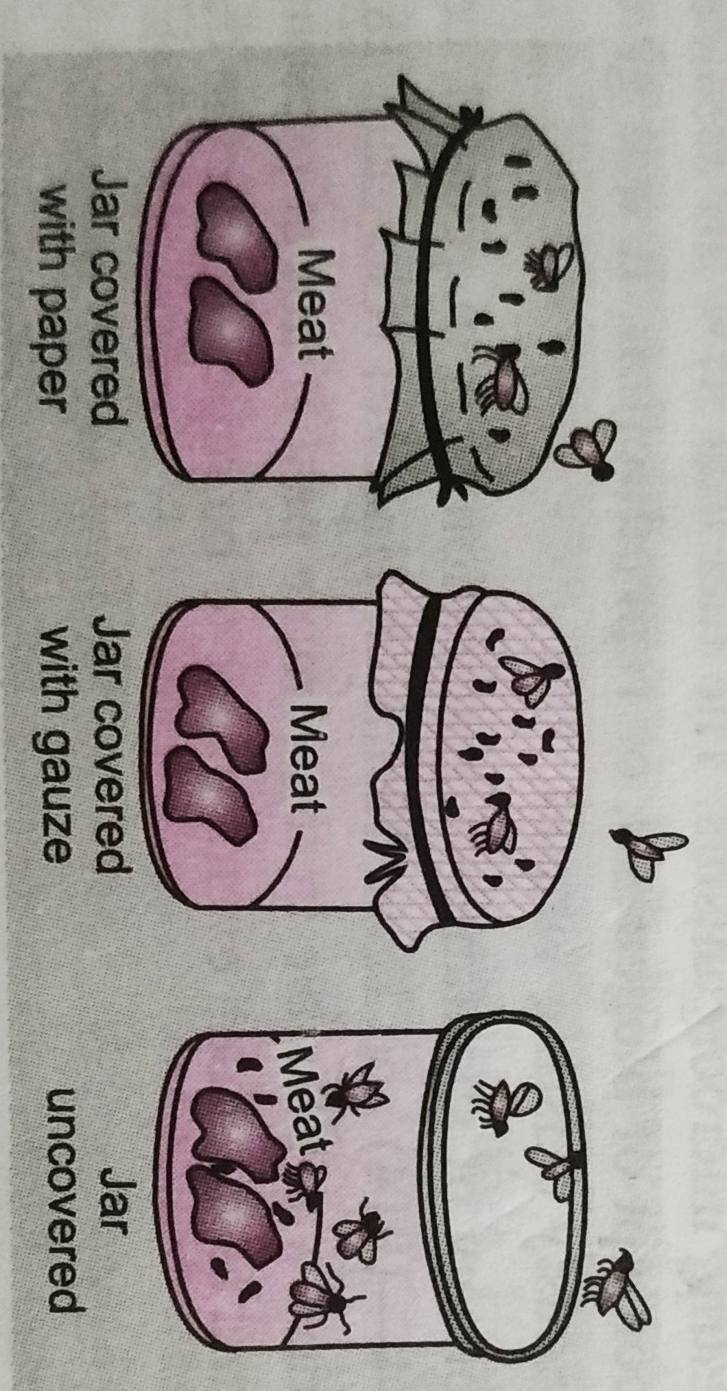
Theory of Spontaneous Generation: Redi’s experiment

Slide 11
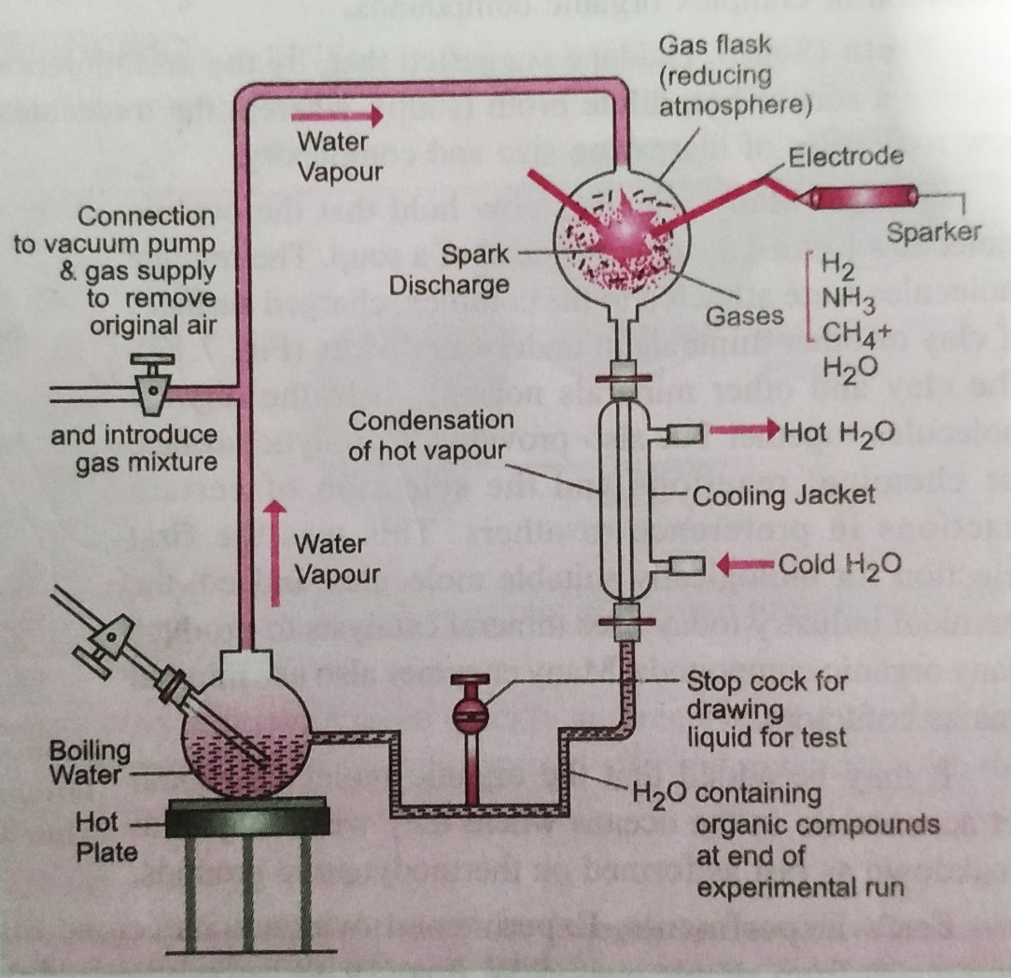
Modern Theory: Miller’s Experiment

